Slide 1
Dengue Cases Prediction
Clara, Irvan

Slide 2
Table of Contents
01
02
03
04
05
Introduction
Data Preparation
EDA
Overview, problem statement, and objectives
Data collection, cleaning, and preprocessing
Data exploration and visualization
Modeling
Recommendation
Time series modeling and performance evaluation
Cost-Benefit analysis and conclusion

Slide 3
01
Introduction
Overview, problem statement and objectives

Slide 4
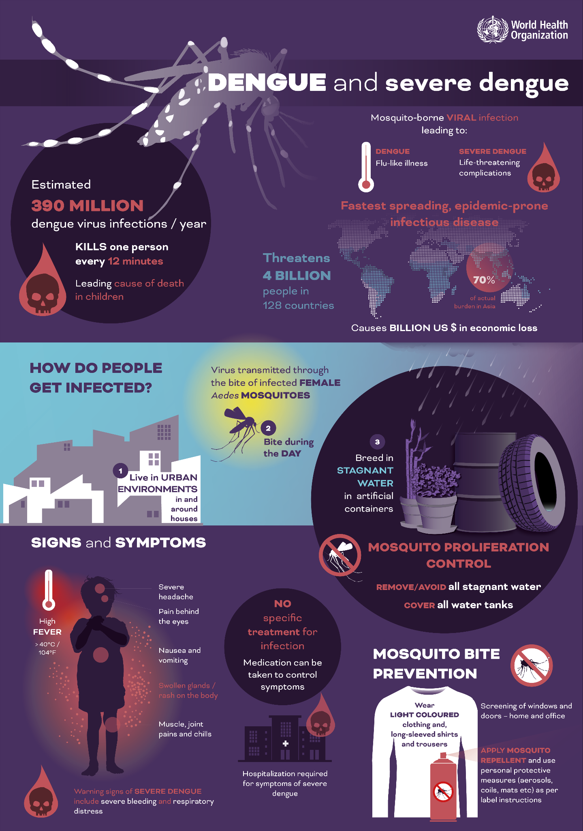
Overview

Slide 5
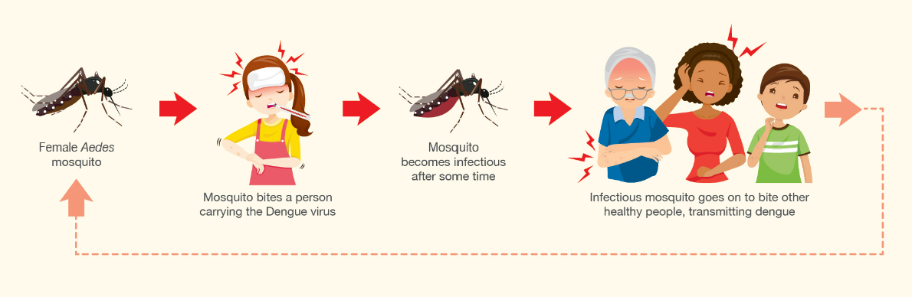
Dengue Transmission
An uninfected female Aedes mosquito gets infected with the Dengue virus when it bites a person infected with dengue
Then transmits dengue to other healthy individuals it bites after that

Slide 6
Understanding Dengue
Dengue Infection
Four different serotypes of dengue virus (DENV-1 to 4) circulating
Weather
Treatment
Optimal breeding for Aedes mosquitos are hot weather and heavier rainfall
No specific treatment for dengue fever. Severe cases may need to be hospitalised

Slide 7
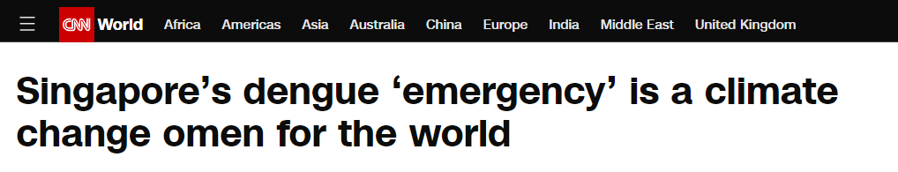
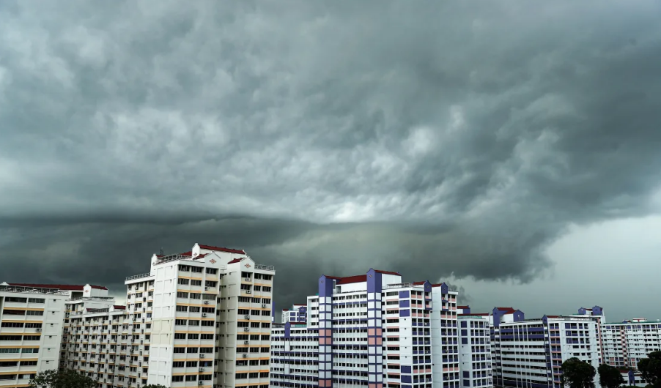
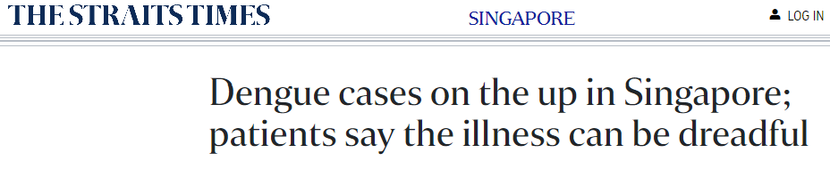
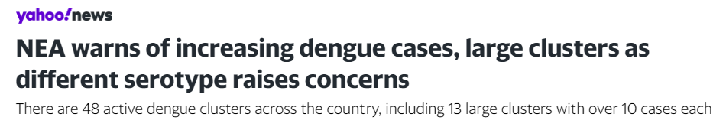
Dengue in Singapore
Singapore an ideal environment for mosquito breeding
High temperatures, rainfall, and humidity
Densely populated city with three million of residents live in HDB flats
Crucial to predict dengue cases and implement dengue prevention program
Allow MOH/NEA and the public to take necessary preventive measures

Slide 8
Problem statement
Predict dengue 1-2 months ahead
Allow MOH/NEA and the public to take necessary preventive measures, such as going down to the different hotspots to conduct checks for potential breeding spots.

Slide 9
02
Data Preparation
Data collection, cleaning, and preprocessing

Slide 10
Data Sources
Dengue Cases
Temperature
Rainfall
Google Trends

Slide 11
Data Cleaning
Filtering
Aggregating
Filtering diseases to only include 'Dengue Fever' or 'Dengue Haemorrhagic Fever'
Aggregating the weekly time series data into a monthly time series format.

Slide 12
03
EDA
Dengue Trend, Weather Conditions, Maps, and Google Trends

Slide 13
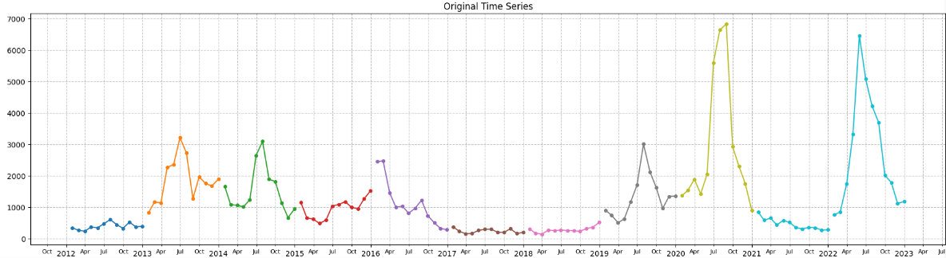
Dengue Cases Across Years
Monthly Dengue Trend in Singapore from 2012 to 2022
Multiple spikes in cases are accompanied by some years with lower incidence
Each year is depicted by a different color in the graph.
Spikes

Slide 14
Serotype Switch: 2013 - 2016
A large epidemic stretching over two years in 2013 - 2014 associated with a switch from serotype 2 (DENV-2) to serotype 1 (DENV-1)
Drastic drop in dengue cases from the gravitraps deployment, ramping up of inspections, and population immunity
Outbreak following a switch from DENV-1 to DENV-2 but quickly brought under control
1
3
2

Slide 15
Controlled Dengue: 2017 - 2018
The lowest figure in the past several years with no uptick of cases observed, attributed to:
Immunity built after a high number of cases from 2013-2014 and early 2016
Community and NEA step up inspection
Implementation of network of Gravitraps

Slide 16
Covid-19: 2019 - 2022
2
3
Uptick due to the switch to DENV-3 serotype and the warmer months
3) Resurgence due to:
Waning immunity
Rise of DENV-3
Higher mosquito population due to increased construction
1
2) Resurgence of epidemic dengue during Covid-19 due to
The rise of DENV-3 and DENV-4 serotypes
The work-from-home arrangement increased probability of contact with mosquitos

Slide 17
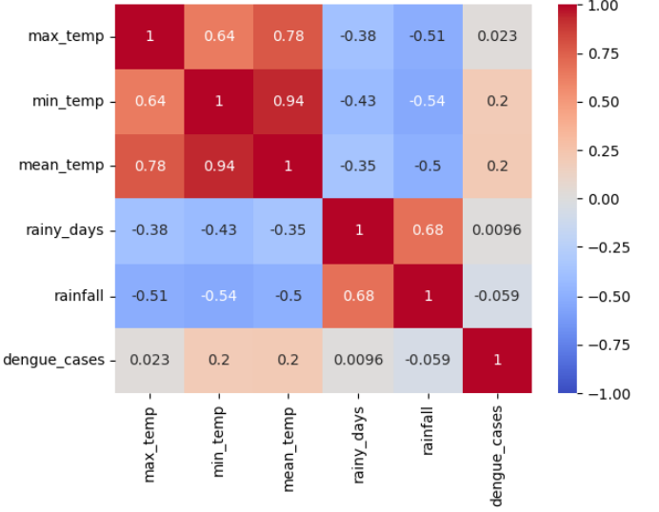
Weather Conditions
Temperature
Max, min, and mean temperature
Weather
The weather conditions across Singapore
Rainfall
Total number of rainy days and total rainfall
Variables used are Mean Temperature and Total Rainfall to avoid multicollinearity

Slide 18
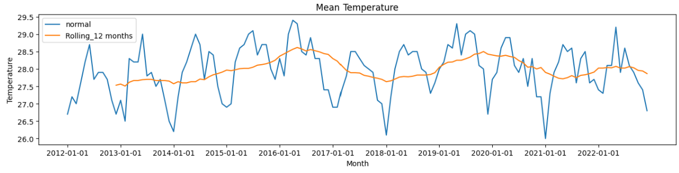
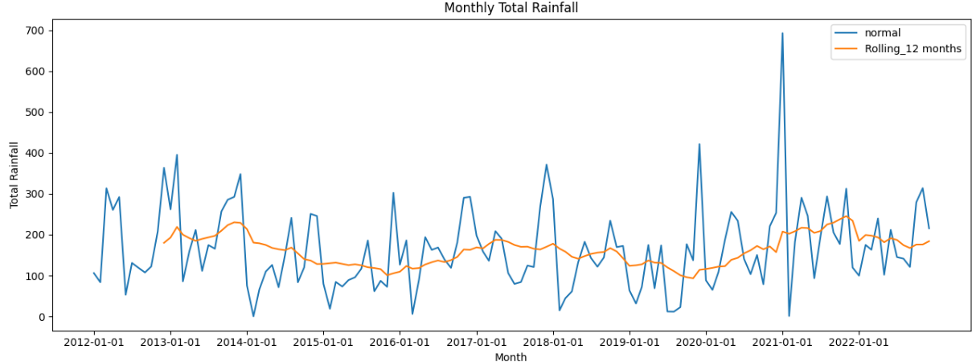
Temperature and Rainfall Trends
Periods of high and low temperature and rainfall
High temperature and rainfall are ideal for Aedes growth

Slide 19
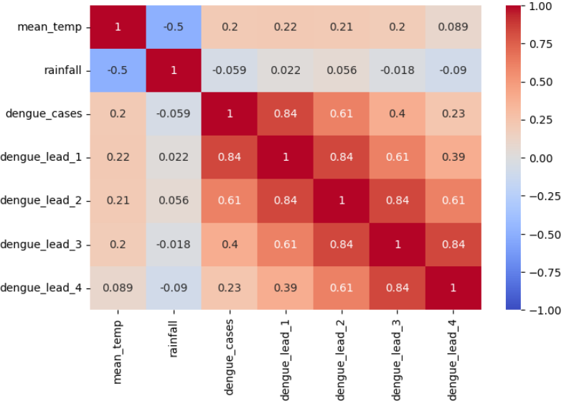
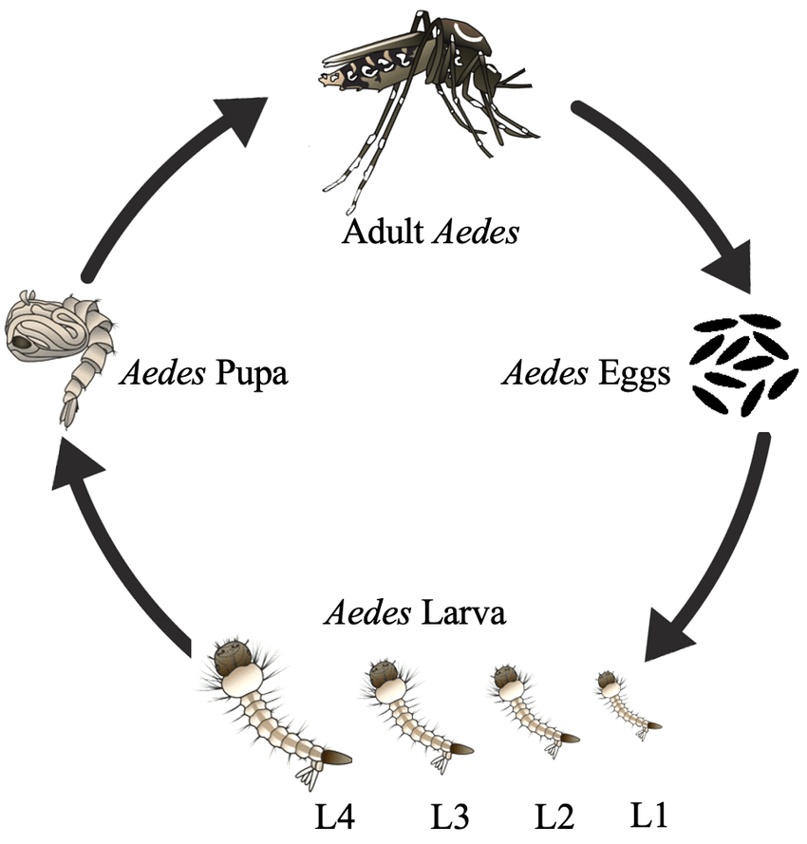
Weather vs Dengue
Research suggests that mean temperature and rainfall precede dengue cases by 3–4 months.
Weak correlation between weather conditions to dengue cases and lead duration

Slide 20
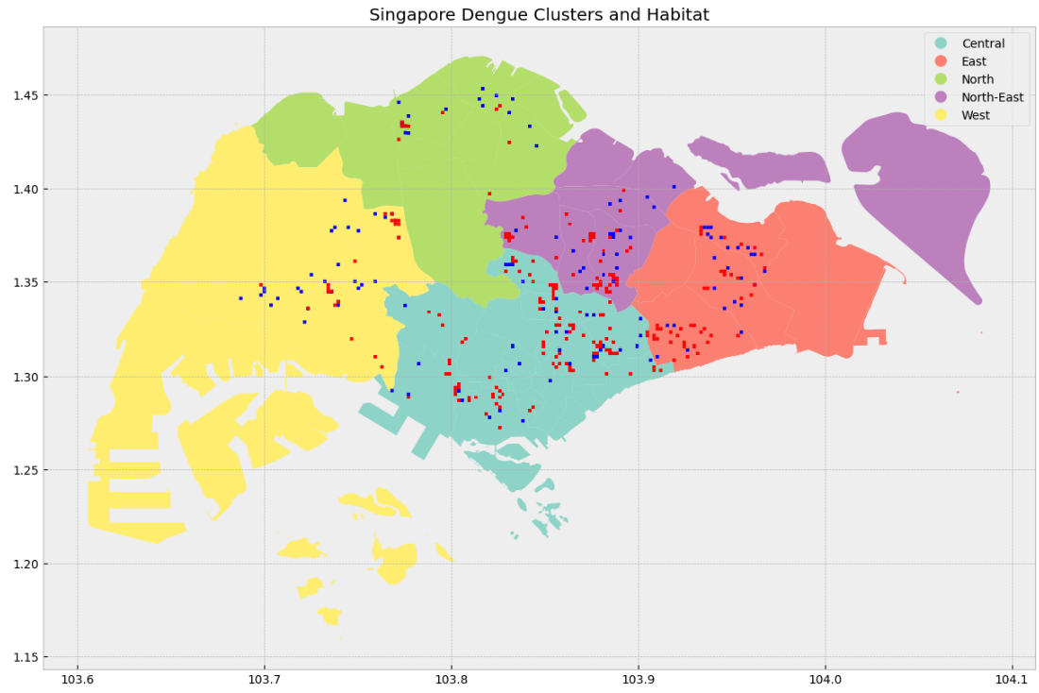
Dengue Clusters and Habitat
GeoJSON data from data.gov.sg
Clusters and habitats in close proximity
There are clusters that are not near habitats
Clusters
Habitats

Slide 21
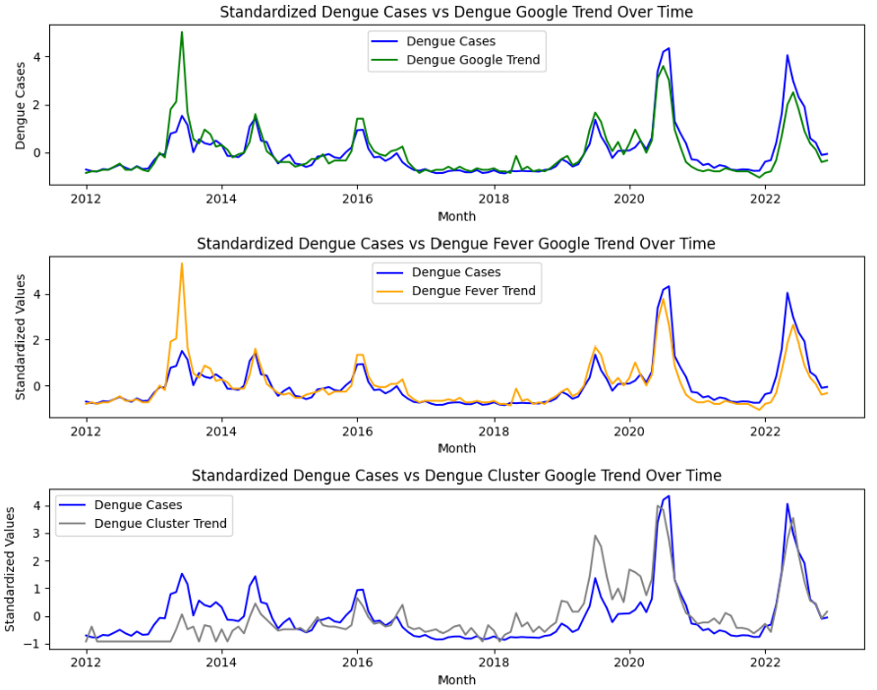
Dengue Google Trends
Keywords searched:
Dengue
Dengue Fever
Dengue Cluster
The trends show that the dengue related google search exhibit similar trends with the dengue cases, all points being standardized

Slide 22
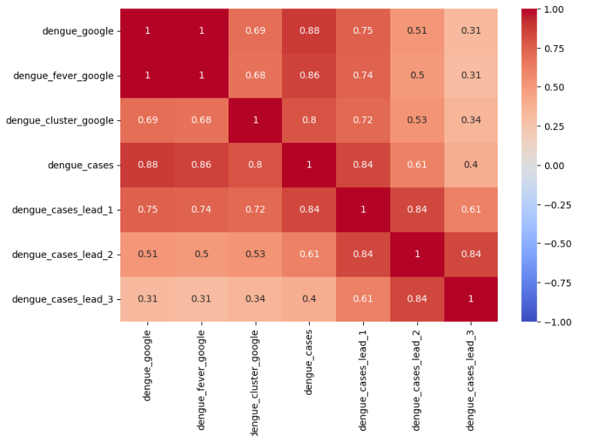
Dengue Google Trend
Strong correlation between dengue cases and google trends
Applied lead 1 month of dengue cases and still observe strong correlation
This shows that Google Trends can potentially be used for an early warning system before dengue outbreak

Slide 23
04
Modelling
Time Series modelling and evaluation

Slide 24
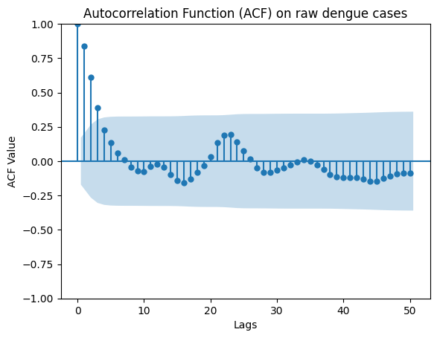
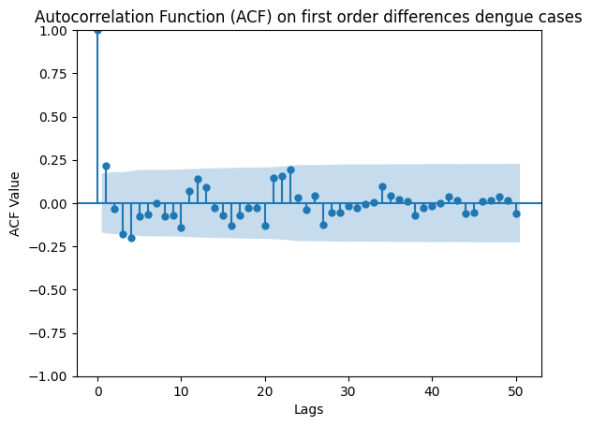
Stationarity
Slow decay suggests that the series is non-stationary, hence differencing is needed.
No.of cases in one month is highly dependent on no.of cases in previous months
Series is now stationary, which should show a rapid decline in autocorrelation after a few lags.

Slide 25
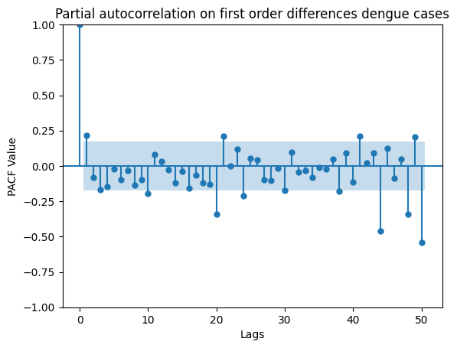
Stationarity
PACF measures the direct effect of a lagged value on the current value, excluding the influence of intermediate values.
Significant spikes indicate strong partial correlations at those lags.

Slide 26
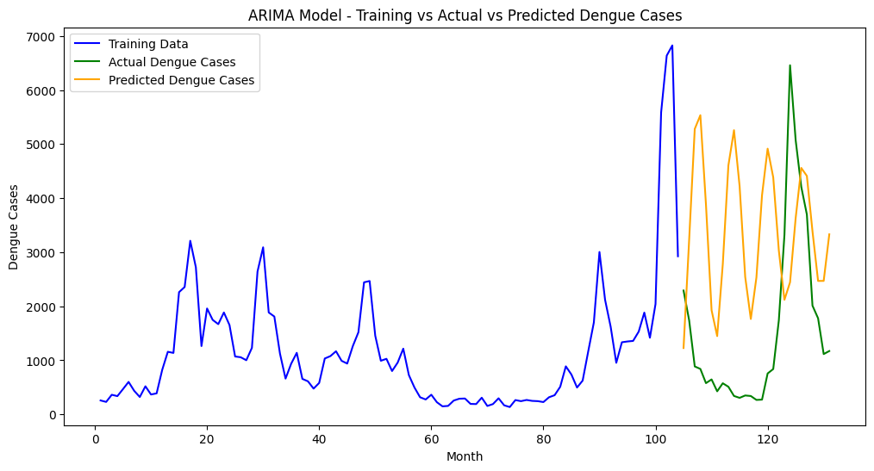
ARIMA (2,1,3)
Test RMSE: 2,764

Slide 27
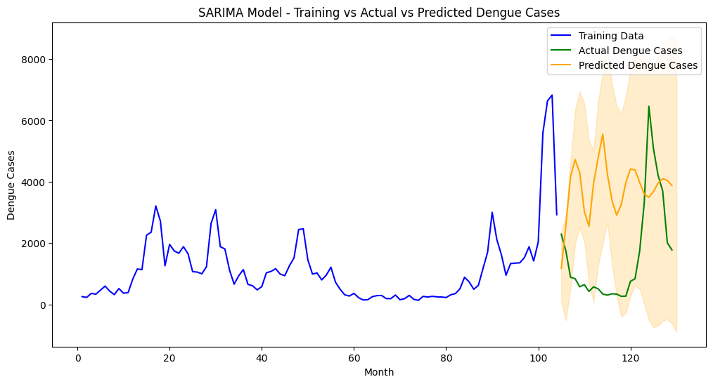
SARIMA (4, 1, 0)
Test RMSE: 2,919

Slide 28
Data preprocessing
Min Max scaler to standardise data
Varied lookback period - indicates how many previous data points will be used to predict the current data point.
Train test split of 80/20 ratio
Dengue cases aggregated by month

Slide 29
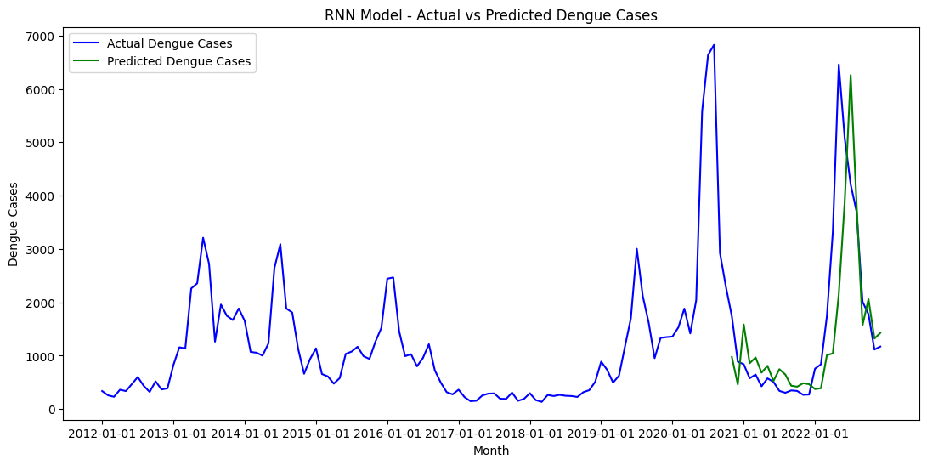
RNN - single feature
Test RMSE: 859

Slide 30
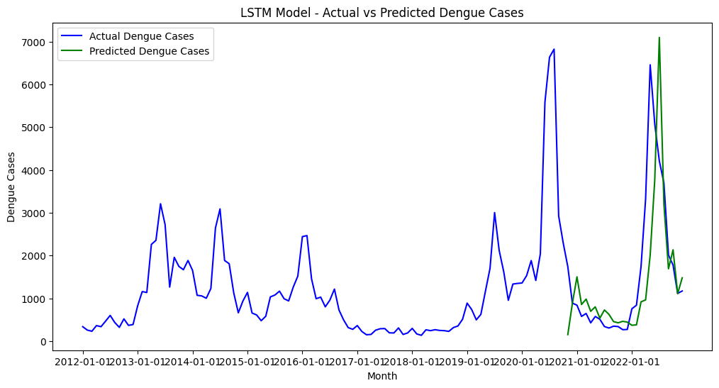
LSTM - single feature
Test RMSE: 1,002

Slide 31
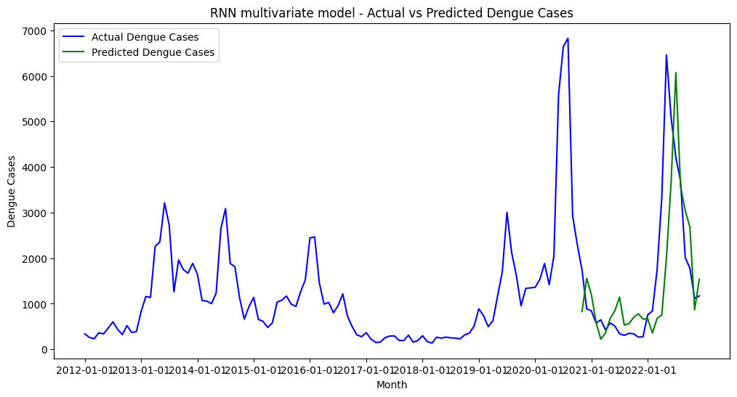
RNN - Multivariate time series forecasting
Test RMSE: 817

Slide 32
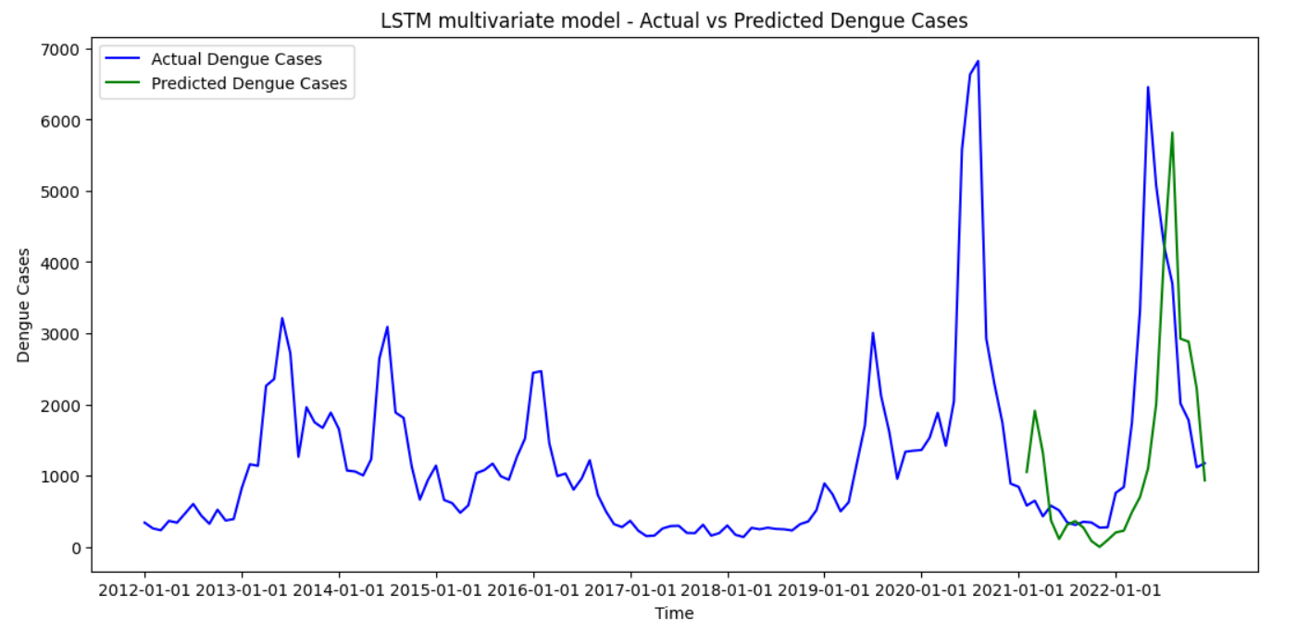
LSTM - Multivariate time series forecasting
Test RMSE: 1,215

Slide 33
Model Evaluation
Log transformation to scale the data over Min Max scaler or standard scaler for the following reasons:
A log transformation reduces the impact of outliers.
Overall RMSE scores performed slightly worse for the test set, but lesser overfitting
Using multiple features for Neural Networks led to a worsening for RMSE scores
In the single feature LSTM vs RNN, the LSTM model did better than RNN because during backpropagation, RNNs suffer from the vanishing gradient problem, where the gradient can become very small and the weights of the neurons are not effectively updated

Slide 34
05
Recommendation
Cost-Benefit Analysis and Conclusion

Slide 35

How does the suppression technology work?
Release of non-biting male Wolbachia-carrying mosquitoes to mate with urban female mosquitoes
When they mate, the eggs derived from these matings do not hatch, thereby, reducing the population of Aedes mosquitoes in the field
What are some common facts?
Wolbachia is a safe, naturally occurring bacterium
Wolbachia DOES NOT harm humans or animals
Male mosquitoes do not bite or transmit disease
Research suggests implementation cost for the whole of Singapore is SGD 40 million

Slide 36
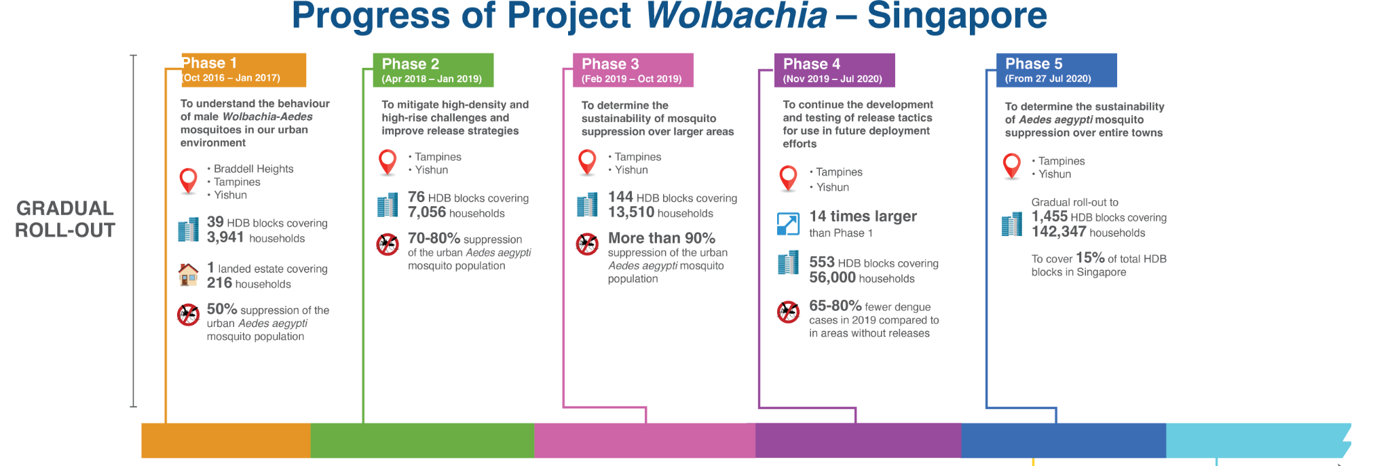
Average dengue cases reduction of 70%
Source: NEA

Slide 37
Wolbachia Global
Indonesia
Colombia
In a cluster randomised trial, dengue was 77% lower
Dengue incidence reduced by 50% in the applied city
Brazil
Australia
Dengue is significantly lower in Wolbachia-treated neighbourhoods of Rio and Niteroi
Dengue has been effectively eliminated as a public health concern in Far North Queensland

Slide 38
Consultation
Blood test, regular consultation, medication
Direct
Cost incurred from consultation and hospitalization
Hospitalization
Average hospital fee for 3 days and doctor attendance
Economic Impact
Calculating the cost per dengue case
Productivity
Typically dengue fever lasts for up to 1 week, resulting in workers unable to work
Indirect
Reduction of work productivity and time required to provide caretaking
Caretaking
Symptomatic children and elderly requires caretaking

Slide 39
Total Economic Impact
 | Direct Cost |  | Indirect Cost
 | Consultation | Hospitalization | Productivity | Caretaking
Percentage | 0.83 | 0.17 | 0.80 | 0.20
Fee (SGD) | 200 | 7,000 | 1,250* | 320**
Total (SGD) | 166 | 1190 | 1,000 | 64
Grand Total (SGD) | 1,356 |  | 1,064
*7 days out of work due to dengue fever
**2 days out of work due to caretaking of children and elderly
1 day out of work equivalent to the median daily annual income, derived from median gross monthly income from MOM data

Slide 40
Impact - SGD 55 M
Cost - SGD 40 M
Benefit - SGD 15 M
Calculation based on 2022 dengue cases of 32,175
Cost of Project Wolbachia implementation to the whole of Singapore
Cost-benefit from implementing Project Wolbachia

Slide 41
Recommendations
Project Wolbachia implementation
Google Trend as early warning system before dengue outbreak
Cluster does not always form in habitat - be vigilant

Slide 42
Thank You!

